Slide 1
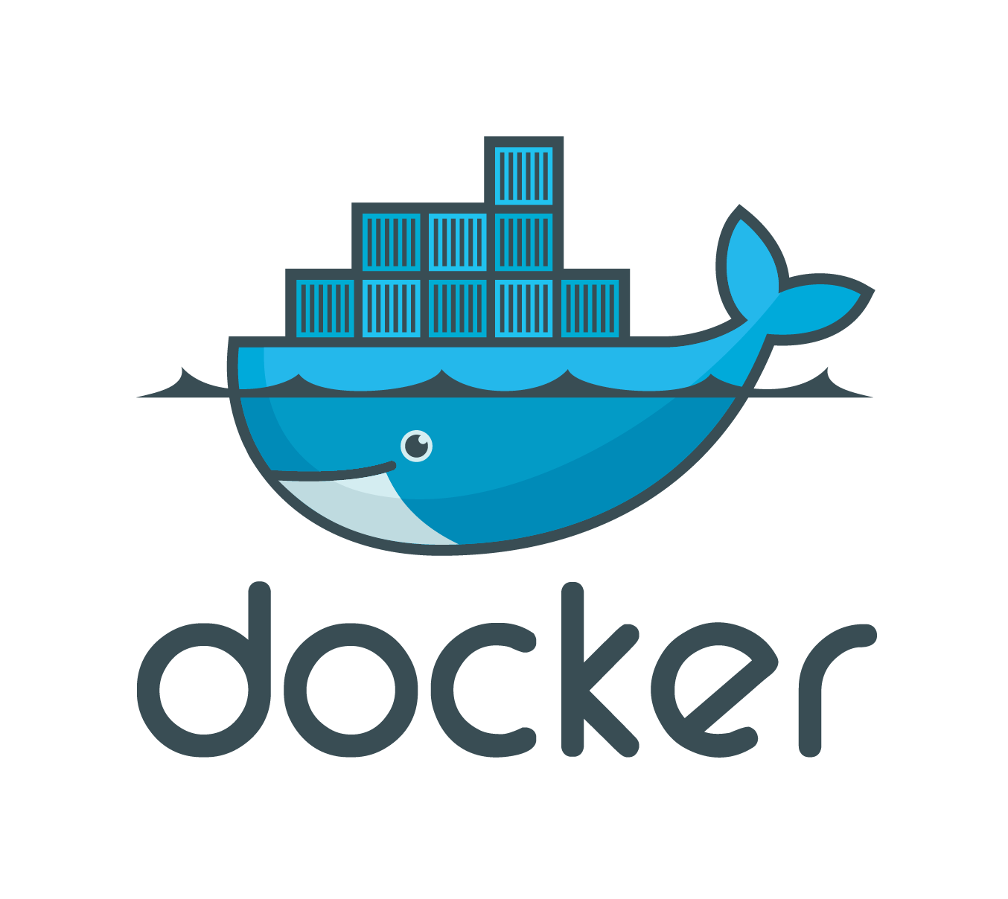
Introduction to Containers
SQL Server On Linux and Docker
Notes:
Welcome to Introduction to Containers.
We’re going to talk about:
Containers
Docker
SQL Server on Linux
….and more specifically, SQL Server on Linux on Docker – hopefully you’re in the right place ;)

Slide 2


Introduction to Containers
Chris Taylor
Worked with SQL Server since 2001
MCSE – Data Platform
Exceptional DBA Award finalist
Damn that Jeff Moden and his RBAR and Tally tables ☺
SQLNE PASS Chapter Group Leader
SQLRelay Organiser (Newcastle)
Formerly one of those “dirty devs”
Contact:
Twitter: @SQLGeordie
Email: chris.taylor@jarrinconsultancy.com
Blog: www.chrisjarrintaylor.co.uk
GitHub: github.com/SQLGeordie

Slide 3
Agenda
Session Aim
What are containers?
Containers vs Virtual Machines
Images
Getting Setup
Volumes
Dockerfile
Docker Hub
Multi-Container Applications

Slide 4
Not on the Agenda
Docker-Machine
Orchestration
Docker-Swarm
Kubernetes
Networking and Linking

Slide 5
Also….Not on the Agenda
Containers / Orchestration in the Cloud
AWS Elastic Container Service (ECS)
Azure Container Service (AKS)
Notes:
Wanting to keep this to a level 100 and purely as an introduction and the issues I had with getting started.
See my other sessions on Docker-Machine, Swarm and Cloud

Slide 6
Session Aim
High(ish) level insight into containers and what you can do with them
Learn by example
Demo’s
My mistakes ☺
Enough of a taste to get the container bug and start experimenting!

Slide 7
Well, it worked on my machine!
Notes:
How many people in the room have heard a developer use the phrase “Well, it worked on my machine?”
This is the lead up to how containers can help eradicate/alleviate this.
Possibly environment differences, data differences etc which cause the change to fail

Slide 8

The Problem
Those pesky Dev’s!!
https://cdn.geekwire.com/wp-content/uploads/2012/02/nerd-bigstock_Extreme_Computer_Nerd_1520708.jpg
Notes:
It’s always the developers fault – isn’t it?
Love to blame developers!
Well no, this day in age we’re all using source control (ask audience the question), building, deploying so we’re all accountable

Slide 9
The Real Problem
Adapting to changing markets
Environmental
Code, system tools, system libraries, settings
Notes:
Organisations are forced to adapt quickly to new and changing markets
Pushing changes out the door as quick as possible to stay ahead of the game
Variances in Environments:
Code, system tools, system libraries, settings
CONTAINERS CAN HELP ALLEVIATE THIS ISSUE.

Slide 10
What are Containers
Next evolution in virtualisation
Lightweight, stand alone, executable package of a piece of software
Separation of applications or services on the same container host
Isolated, resource controlled, and portable operating environment
Enables true independence between applications / infrastructure / developers / IT ops
“Basically, a container is an isolated place where an application can run without affecting the rest of the system, and without the system affecting the application.”
https://docs.microsoft.com/en-us/virtualization/windowscontainers/quick-start/
Notes:
Concept of “Lift and Shift”
Sometimes seen as OS virtualisation
A container image is a lightweight, stand alone, executable package of a piece of software that includes everything needed to run it
Code, system tools, system libraries, settings
Available for Linux and Windows based applications, containerised software will always run the same regardless of the environment
Containers isolate software from it’s surroundings for example, differences between development and staging environments and help reduce conflicts between teams running different software on the same infrastructure
Windows Server Containers are a lightweight operating system virtualization method used to separate applications or services from other services running on the same container host.
To enable this, each container has its own view of the operating system, processes, file system, registry, and IP addresses.

Slide 11
Container History
1979 – Unix v7 (chroot)
2000 – FreeBSD Jails
2001 – Linux VServer
2004 – Oracle Solaris Containers
2005 – Open Virtuzzo
2006 – Process Containers
2008 – Linux Containers (LXC)
2011 – Cloud Foundry Warden
2013 – Let Me Contain That For You (LMCTFY)
2013 – Docker and the Future
2015 – VMWare vSphere and Container Integration (Project Bonneville)
Hybrid virtualisation with vSphere and vCloud Director
2016 – Windows Server 2016 and Windows 10 (Pro/Anniversary) support
http://blog.aquasec.com/a-brief-history-of-containers-from-1970s-chroot-to-docker-2016
Notes:
1979 – Chroot
changing the root directory of a process and its children to a new location in the filesystem. This advance was the beginning process isolation: segregating file access for each process
2013 - Mention LMCTFY
Google creates container for everything, Search, Gmail, Google Docs etc you’re issued a new container!
Docker 2013 –
Applications rely on a common OS kernel
Approach can work only for applications that share the exact OS version.
Docker found a way to address this limitation
http://blog.aquasec.com/a-brief-history-of-containers-from-1970s-chroot-to-docker-2016

Slide 12
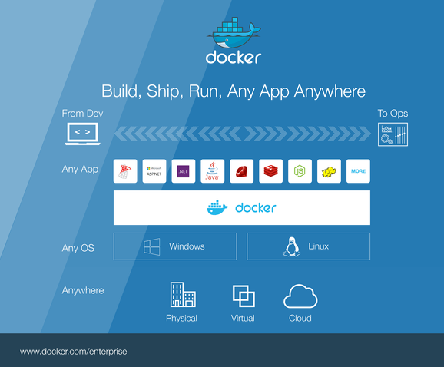
What is Docker?
Notes:
- Docker Engine, the open source runtime that builds, runs and orchestrates containers.
Focuses on Build, Ship, Run
Microsoft Partnership 2014, integration with Win 2016 and available on Windows 10 as well as Azure
- Open Source project setup by dotCloud (PaaS company) in 2010 by Solomon Hykes.
- On September 19, 2013, dotCloud and Red Hat announced an alliance.
- On October 29, 2013 dotCloud, Inc was renamed to Docker, Inc.
Containerized applications share a common operating system kernel, eliminating the need for each instance to run on its own separate operating system. An application can be deployed in a matter of seconds and using fewer resources than with hypervisor-based virtualization.
However, since the applications all rely on a common OS kernel, this approach can work only for applications that share the exact OS version. Docker found a way to address this limitation.
Docker was released as an open source project by dotCloud, a platform as a service company, in 2013. Docker relies on Linux kernel features, such as namespaces and cgroups, to ensure resource isolation and to package an application along with its dependencies. This packaging of the dependencies enables an application to run as expected across different Linux operating systems—supporting a level of portability that allows a developer to write an application in any language and then easily move it from a laptop to a test or production server—regardless of the underlying Linux distribution. It’s this portability that’s piqued the interest of developers and systems administrators alike.

Slide 13
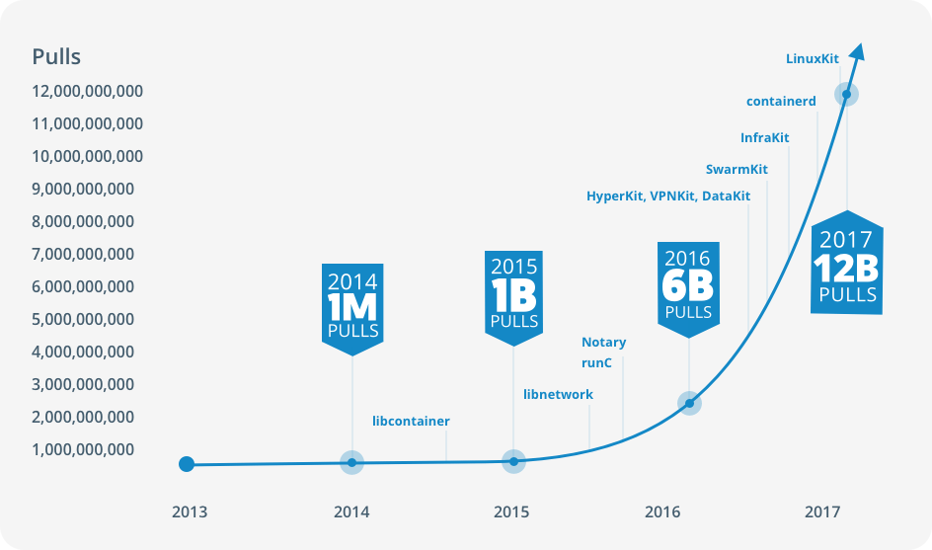
https://www.docker.com/what-container
Notes:
The launch of Docker in 2013 jump started a revolution in app development - by bringing software containers to the masses. In just a few years, Docker has transformed the industry with a new lexicon, framework and standards in app development, packaging and management.
Starting with the pivot of dotCloud and turning a piece of dotCloud into a better Linux container technology - one that is portable, flexible, and easy to deploy. Docker open sourced the libcontainer and partnered with a worldwide community of contributors to further its development. By June 2015, just a couple short years later, Docker donated the specification and runtime code now known as runC, to the Open Container Initiative (OCI) to help establish standardization as the container ecosystem grows and matures.
Following this evolution, Docker continues to give back with the containerd project. Containerd is the core container runtime of the Docker engine daemon, an industry-standard container runtime with an emphasis on simplicity, robustness and portability, designed as an embeddable component for higher level systems. Docker engine is built on runC and containerd. This collaborative project enables portability for developers, container standardization through the OCI, a growing ecosystem of tools, and a free marketplace of images - pre-made apps that the community can share and build on.

Slide 14
Kernel
The core of the OS
Application requests will go through this
Controls everything from access to the HDD to memory management
Runs in it’s own memory space
“It can be thought of as the program which controls all other programs on the computer”
https://simple.wikipedia.org/wiki/Kernel_(computer_science)
Notes:
Before we move on, just want to touch very briefly on something that is mentioned a lot in the Container world – The Kernel
The core or the brain of the OS which controls access to CPU, memory, disks
Runs in its own memory space so applications cannot modify it

Slide 15
Container Terminology – The Basics
Container Host
Physical or Virtual computer system configured with the Windows Container feature.
Container OS Image
Containers are deployed from images. The container OS image is the first layer in potentially many image layers that make up a container. This image provides the operating system environment.
Container Image
A container image contains the base operating system, application, and all application dependencies needed to quickly deploy a container.
Container Registry
Container images are stored in a container registry, and can be downloaded on demand.
Dockerfile
Dockerfiles are used to automate the creation of container images.
Notes:
Before we dive in to a few demos, lets run through some terminology
Images are comprised of multiple layers
A layer is just another image
Every Image contains a Base Layer
Docker uses a copy of write system
Layers are read only:
Base layer
Writeable layer

Slide 16
Container Overview
Notes:
Consolidation:
Average container size can be very small (Not Windows/SQL Server - ~12GB)
Less Resource Intensive
Server can host significantly more containers than virtual machines.
Low Cost:
Potentially decrease your operating cost (less servers, less staff) and your development cost (develop for one consistent runtime environment).
Speed:
Can spin up in seconds
Decrease the time needed for development, testing, and deployment of applications and services
Consistency:
Simplify deployments, no difference between running your application locally, on a test server, or in production.
Great option for microservices, DevOps and continuous deployment.

Slide 17
Pros
Consolidation:
Average container size can be very small (Not Windows/SQL Server - ~12GB)
Less Resource Intensive
Server can host significantly more containers than virtual machines.
Low Cost:
Potentially decrease your operating cost (less servers, less staff) and your development cost (develop for one consistent runtime environment).
Speed:
Can spin up in seconds
Decrease the time needed for development, testing, and deployment of applications and services
Consistency:
Simplify deployments, no difference between running your application locally, on a test server, or in production.
Great option for microservices, DevOps and continuous deployment.
Notes:
- The average container size is within the range of tens of MB while VMs can take up several gigabytes. Therefore a server can host significantly more containers than virtual machines.
- Running containers is less resource intensive then running VMs so you can add more computing workload onto the same server.
- Provisioning containers only take a few seconds or less, therefore, the data center can react quickly to a spike in user activity.
- Containers can enable you to easily allocate resources to processes and to run your application in various environments.
- Using containers can decrease the time needed for development, testing, and deployment of applications and services.
- Testing and bug tracking also become less complicated since you there is no difference between running your application locally, on a test server, or in production.
- Containers are a very cost effective solution. They can potentially help you to decrease your operating cost (less servers, less staff) and your development cost (develop for one consistent runtime environment).
- Container-based virtualization are a great option for microservices, DevOps, and continuous deployment, environments where you need to have self contained / portable code which can be spun up and thrown away at will
https://medium.com/flow-ci/introduction-to-containers-concept-pros-and-cons-orchestration-docker-and-other-alternatives-9a2f1b61132c

Slide 18
Cons
Security:
Sharing of the Kernel / OS Components means less isolation
Hyper-V Containers can help here
OS Flexibility:
Becoming less of an issue with Windows Integration and the Docker CLi.
Networking:
Can be tricky
Maintaining connections whilst maintaining isolation
Management:
Seen as an art
Various tools becoming more popular (ie. Swarm/Kubernetes)
Notes:
- One of the main disadvantages of container-based virtualisation compared to traditional virtual machines is security. Containers share the kernel, other components of the host operating system, and they have root access. This means that containers are less isolated from each other than virtual machines, and if there is a vulnerability in the kernel it can jeopardize the security of the other containers as well.
- Virtual Machines only share the hypervisor which has less functionality and less prone to attacks than the shared kernels of the containers. The system hardware is presented to the VMs in a virtualized form so intrusions, viruses, and other malicious activities cannot spread over to other VM.
- Less flexibility in operating systems. You need to start a new server to be able to run containers with different operating systems. While virtual machines with any kind of OS can live next to each other on the same server. This might not be a problem for hosting providers, but for complex enterprise application this can be a serious constrain.
- Another challenge is networking. Deploying containers in a sufficiently isolated way while maintaining an adequate network connection can be tricky. There are solutions that are addressing this issue such as Weave Net 1.5 but as it looks like at the moment there is still room to improve.
- Security: An advantage of using VMs is the abstraction at the physical hardware level that translates to individual kernels; these individual kernels limit the attack surface to the hypervisor. In theory, vulnerabilities in particular OS versions can't be leveraged to compromise other VMs running on the same physical host. Since containers share the same kernel, admins and software vendors need to apply special care to avoid security issues from adjacent containers.
- Management: Solutions such as Docker make container management easier, but many customers still find container management more of an art than a science. One customer who has been running Docker recently wrote about shared his experience and his frustration of managing Docker in a production environment.
https://medium.com/flow-ci/introduction-to-containers-concept-pros-and-cons-orchestration-docker-and-other-alternatives-9a2f1b61132c

Slide 19
So how are Containers different to VMs?

Slide 20
Virtual Machine vs Containers
Virtual Machines
Windows Containers
Contain a complete operating system and applications
Hypervisor-based virtualization can be resource intensive
Can be large
Hypervisors used to share and manage hardware
Virtual machines residing on the same host can run different operating systems
Bound by the host operating system / daemon, containers on the same server use the same OS
Smaller size
Windows Images still large(ish)
Virtualizing the underlying operating system
Share the kernel of the host OS to access the hardware
Best Practice - 1 process per container
Portability
Notes:
VM:
Own kernel and they don’t use and share the kernel of the host OS, hence they isolated from each other at a deep level.

Slide 21
Virtual Machine vs Windows Container
Virtual Machines
Windows Container
Notes:
Containers are isolated but share OS Kernel and where appropriate, Binaries and Libraries.
Only has the binaries and libraries it needs

Slide 22
Windows Containers vs Hyper-V Containers
Windows Server containers
Hyper-V containers
Multiple container instances can run concurrently on a host
Provide application isolation through process and namespace isolation technology.
Shares a kernel with the host and all containers running on the host
Simplifies patching!
Multiple container instances can run concurrently on a host
Each container runs inside of a special virtual machine.
Kernel level isolation
Windows 10 always runs Hyper-V containers
Notes:
Focus on isolation and security
Hyper-V slower to spin up

Slide 23
Windows Containers vs Hyper-V Containers
Windows Container
Hyper-V Container
Notes:
A Hyper-V container is a Windows Server container running inside a stripped down Hyper-V VM that is only instantiated for containers.
This provides additional kernel isolation and separation from the host OS that is used by the containerized application.
Hyper-V containers automatically create a Hyper-V VM using the application’s base image and the Hyper-V VM includes the required application binaries, libraries inside that Windows container.
Whether your application runs as a Windows Server container or as a Hyper-V container is a runtime decision.
Additional isolation is a good option for multi tenant environments.
No changes are required to the Dockerfile or image, the same image can be run in either mode.

Slide 24
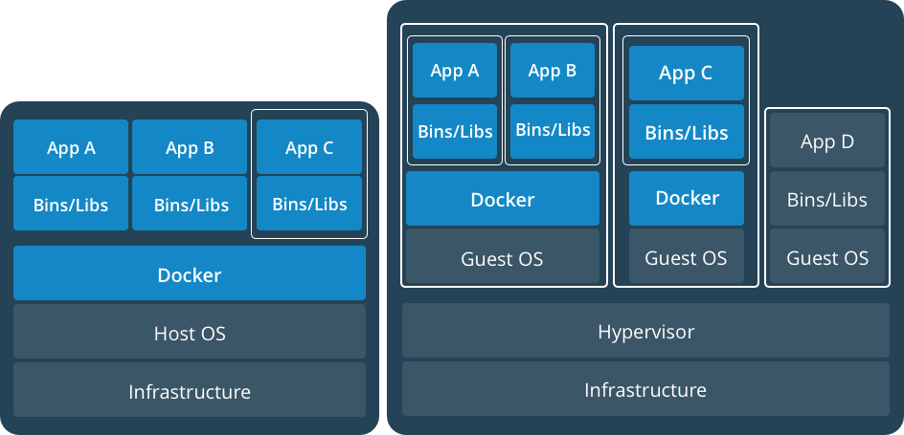
Containers and VMs Together
https://www.docker.com/what-container
Notes:
Containers and VMs used together provide a great deal of flexibility in deploying and managing apps.

Slide 25
What do I need to get setup?
Downloads
Host Machine Setup
Enable Features
Installing the Docker Engine
Hyper-V setup
If you wish to use a VM as the Host
Notes:
This is based on building a VM to run docker.
NOTE: This is not a supported configuration!!
https://docs.docker.com/docker-for-windows/troubleshoot/#running-docker-for-windows-in-nested-virtualization-scenarios
Nested Virtualisation will not be required if not!

Slide 26
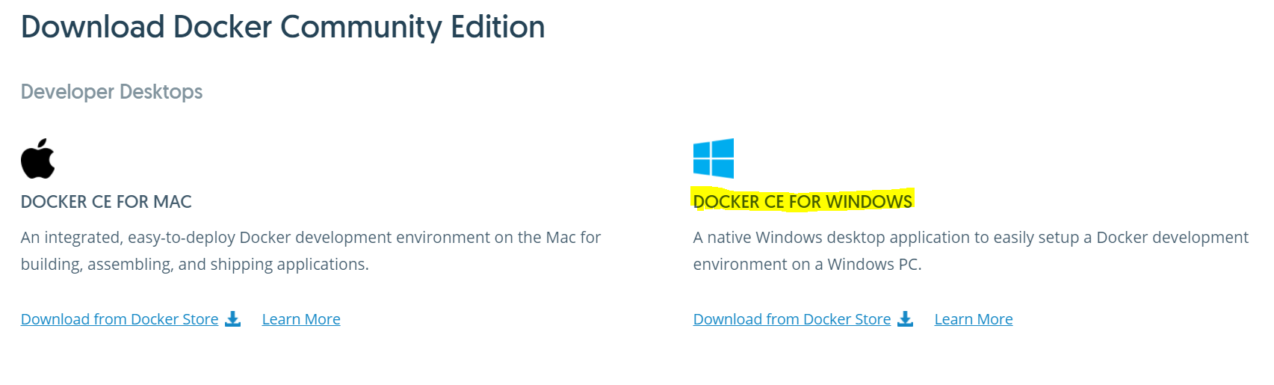
Downloads
Can run Docker direct from host/dev machine
but I don't like installing anything locally I don't have to ☺
Download:
Docker for Windows (Used for Windows 10)
SSMS 17.X (or other compatible version)
OR SQL Server Operations Studio…
https://www.docker.com/community-edition#/download
Notes:
Note that I am using the Community edition

Slide 27
Host Machine Setup
Enough RAM for VM running Docker (Minimum 3250MB for Docker)
OS – Windows 10 Pro, Enterprise and Education (with Anniversary Update)
Host processors require nested virtualisation
Enable Hyper-V on Host
Hyper-V Settings
Create Virtual Switch with External Access
Docker Toolbox if your machine does not meet the requirements
Notes:
This is based on using Windows 10, can use Windows Server 2016
Need Virtual switch in order to access internet, ie. Docker pull

Slide 28
Installing the Docker engine (Windows 10)
Enable-WindowsOptionalFeature -Online -FeatureName:Microsoft-Hyper-V -All
# Download script and run:
.\Enable-NestedVm.ps1 "Win10_Docker“
Install Docker for Windows
docker container run hello-world:nanoserver
Notes:
Check whether the docker package still fails on Win10
Check if Nuget is included in PSv6?

Slide 29
Installing the Docker EE engine (Windows Server 2016)
# PowerShell module from Docker Inc.
Install-Module -Name DockerProvider –Force (Or use DockerMSFTProvider)
# Install package docker from the provide DockerMsftProvider (does not work on Win10)
Install-Package -Name docker -ProviderName DockerProvider –Force (Or use DockerMSFTProvider)
Restart-Computer -Force
# Test running a container
docker run hello-world:nanoserver
Notes:
Check whether the docker package still fails on Win10
Check if Nuget is included in PSv6?

Slide 30
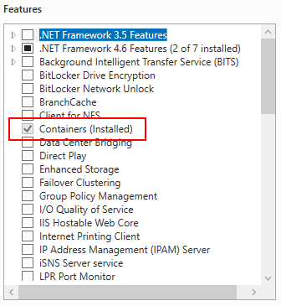
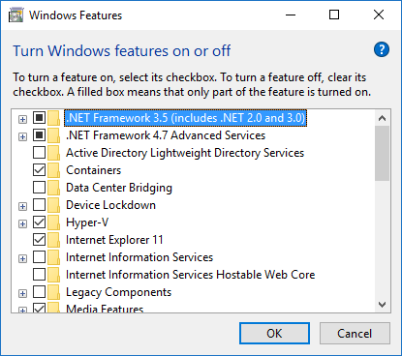
Enable Features
Windows Server 2016
Windows 10
Notes:
NOTE: Enable Containers on Win10 if you want to run windows containers
This is the output of the features installed by the scripts, can be done via gui but make sure do these before installing docker

Slide 31
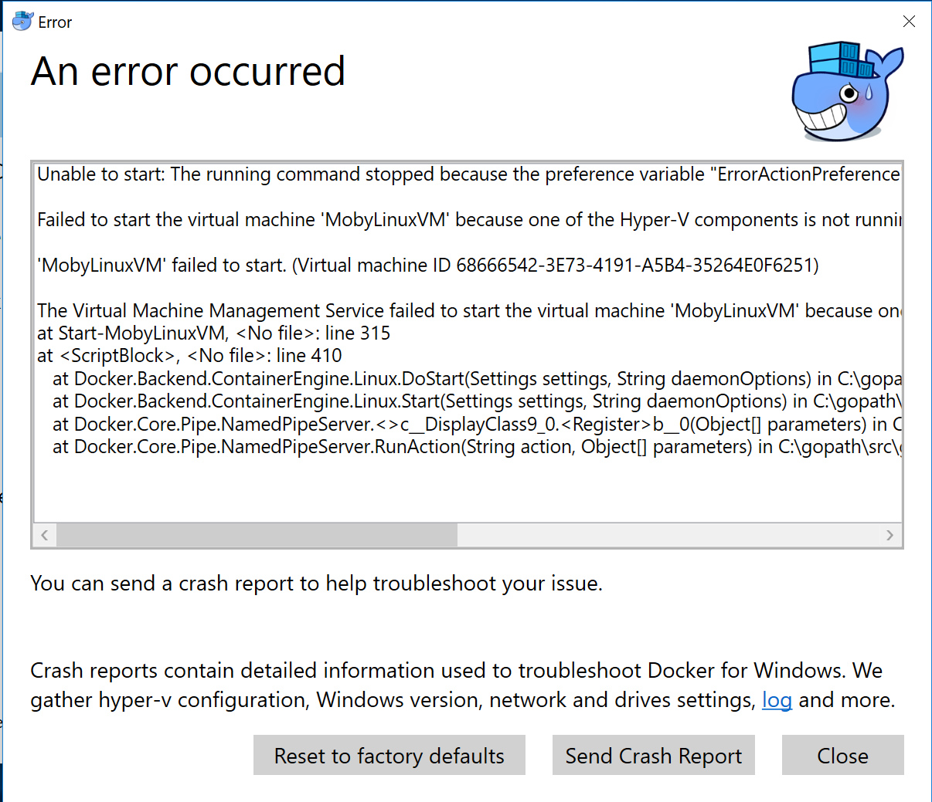
Notes:
This is a typical error you will see when things aren’t working, difficult to decipher but tends to be either you’ve not enabled nested virtualisation, installed docker before enabling containers or not opened ports

Slide 32
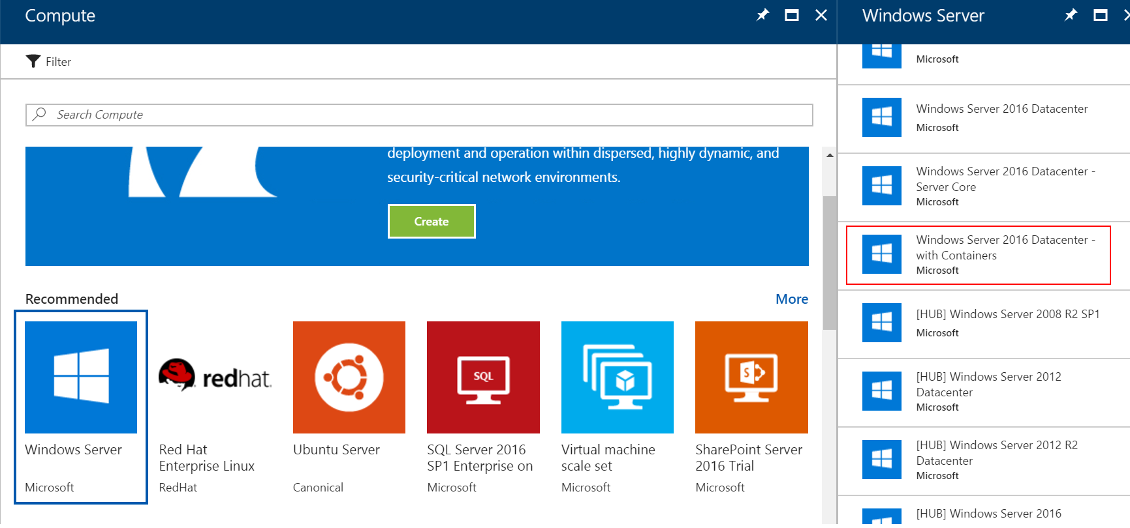
Containers on Azure
Notes:
Container images available on Azure
Also AWS, Digital Ocean

Slide 33
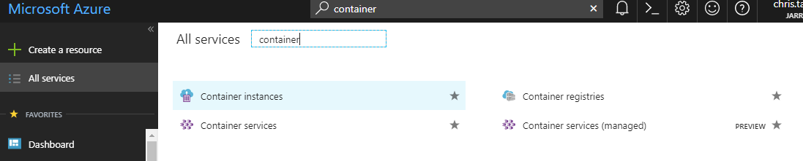
Containers on Azure
Container Instances
Containers as a Service (CaaS)
Notes:
Containers as a Service (CaaS) available on Azure (AKS) and AWS (ECS)
Briefly mention them
These are out of scope of this level 100 session, see my other session for more on these.

Slide 34
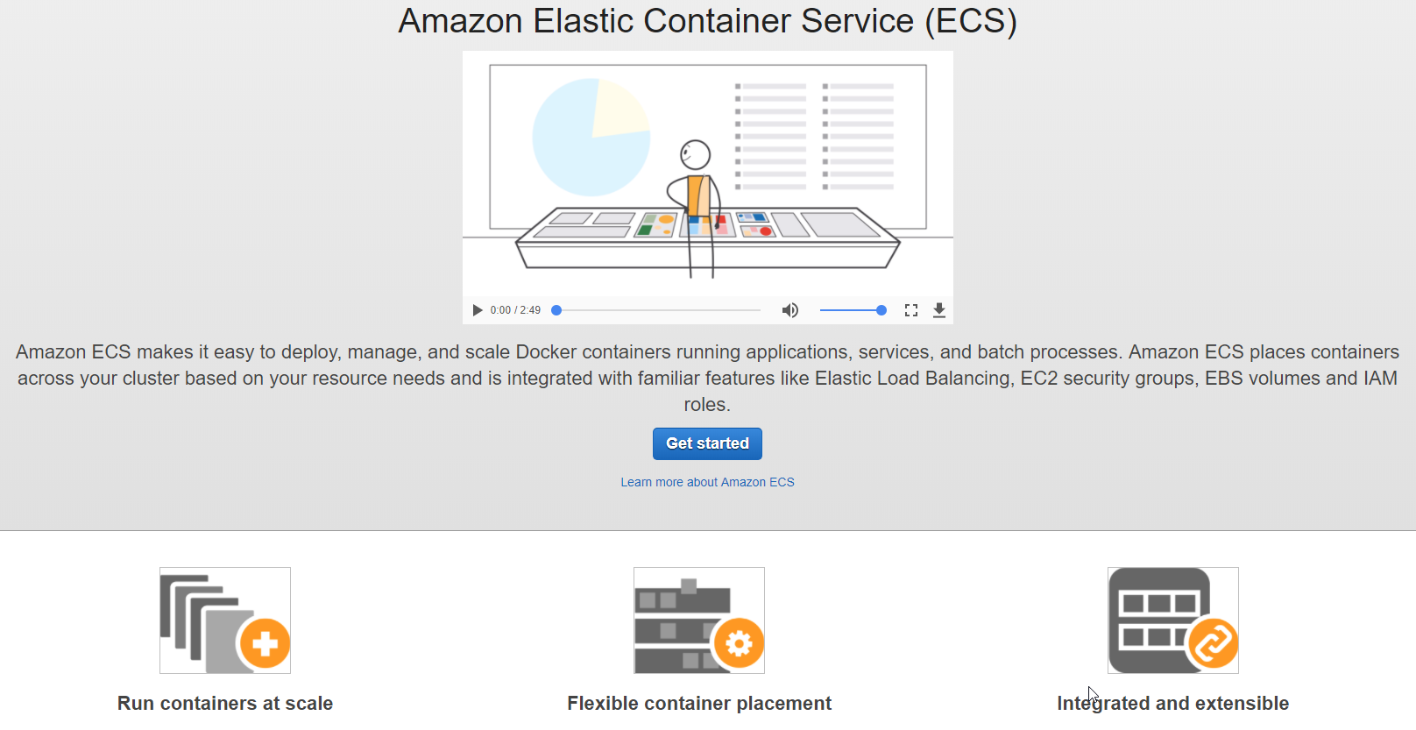
Containers on AWS (ECS)
Notes:
Containers as a Service (CaaS) available on Azure (AKS) and AWS (ECS)
Briefly mention them
These are out of scope of this level 100 session, see my other session for more on these
Amazon ECS
Clusters
Task Definitions
Amazon ECR
Repositories

Slide 35
Hyper-V Setup – Windows 10 Pro
Build a Hyper-V VM with either Windows 10 Pro or Anniversary Edition
Enable Nested Virtualisation
Install SSMS
If you wish to use it!
Install Docker for Windows
Enable Hyper-V
(Win 10 always Hyper-V Containers)

Slide 36
Hyper-V Setup – Windows Server 2016
Build a Hyper-V VM with Windows Server 2016
Install PowerShell Module
(DockerProvider)
Install PowerShell Package
(DockerProvider)
Install SSMS
If you wish to use it!
Enable Hyper-V
(if you wish to use Hyper-V containers)

Slide 37
Windows Firewall Issue?
Different menu’s if you have the firewall enabled
Cannot share drives from Host to Container
Possible Fixes:
Port 445 blocked?
Allow connection to 10.0.75.1 port 445 (the Windows host) from 10.0.75.2 (the virtual machine)
Restriction on network profile?
vEthernet (DockerNAT) to Private?
Disable/Enable “File and Printer Sharing for Microsoft Networks”?
Essentially Opening port 445!
Notes:
Docker for Windows on Windows 10 will show different menu’s if you have the firewall enabled
Add rules to firewall – see AVG

Slide 38
Docker Commands
docker version
docker search <imagename>
docker pull <imagename>:<tag>
docker images
docker run <parameters>
docker ps –a
docker inspect <containername>
docker logs <containername>
docker stop <containername>
docker start <containername>
docker commit
docker push <imagename>
docker rm <containername>
docker rmi <imagename>
Notes:
This is a list of some, not all!
Highlighted the ones we’ll cover in the demo’s

Slide 39
Volumes vs Mounts
Volumes
Bind Mounts
Does not increase size of the container
Easier to back up or migrate than bind mounts.
Work on both Linux and Windows containers.
Can be safely shared among multiple containers.
Volume drivers allow you to store volumes on remote hosts or cloud providers, to encrypt the contents of volumes, or to add other functionality.
Host file/folder is mounted into a container
Limited functionality compared to volumes
Not portable between images
Rely on the host machine’s filesystem having a specific directory structure available
Notes:
Volumes are the preferred mechanism for persisting data generated by and used by Docker containers. While bind mounts are dependent on the directory structure of the host machine, volumes are completely managed by Docker. Volumes have several advantages over bind mounts:
Volumes are easier to back up or migrate than bind mounts.
You can manage volumes using Docker CLI commands or the Docker API.
Volumes work on both Linux and Windows containers.
Volumes can be more safely shared among multiple containers.
Volume drivers allow you to store volumes on remote hosts or cloud providers, to encrypt the contents of volumes, or to add other functionality.
A new volume’s contents can be pre-populated by a container.
In addition, volumes are often a better choice than persisting data in a container’s writable layer, because using a volume does not increase the size of containers using it, and the volume’s contents exist outside the lifecycle of a given container.

Slide 40
SQL on Linux Container DEMO
Notes:
1 – Run Full_Demo_Script.ps1
Showing search, pull etc
2 – Volumes
3 – Breaking LINUX by deleting files and restarting (if there is time)

Slide 41

That’s fantastic, but I have a gazillion databases to restore!!!
http://giftsforlearning.com/wp/tough-questions-with-no-good-answers-whats-a-parent-to-do/
Notes:
Will be time consuming to spin up a container then restore all those DBs, this is where creating your own custom image can help.
Image could contain all the configurations, DBs, logins etc required so when you spin it up everything is there, ready for you to start

Slide 42
Dockerfile
Contains instructions (commands) to create an image
Each instruction creates a layer!
Automate builds using docker build
Dockerfile – no file extension
docker build -t newimagename .
Notes:
Use a Dockerfile to create an image with the relevant DBs etc
A text document that contains all the commands to create an image

Slide 43
Beware!
Be careful with creating too many (unnecessary?) instructions
Remember the layering?
Wrap the instructions into minimal layers / commits:
Multiple Layer Image | Simplified Image
FROM microsoft/mssql-server-linux:latest WORKDIR /usr/src COPY ./shell /usr/src/sqlscript RUN chmod +x /usr/src/restoredb1.sh RUN chmod +x /usr/src/restoredb2.sh RUN chmod 755 /usr/src CMD /bin/bash ./entrypoint.sh | FROM microsoft/mssql-server-linux:latest WORKDIR /usr/src COPY ./shell /usr/src RUN chmod +x /usr/src/restoredb1.sh && \ chmod +x /usr/src/restoredb2.sh && \ chmod 755 /usr/src CMD /bin/bash ./entrypoint.sh

Slide 44
NOTE!!
Repository must be lowercase
docker build imagenamehere .
ENV attach_dbs doesn't work for Linux containers
Works on Windows containers
COPY and run .sql in shell (sh) scripts OR
sqlcmd CREATE DATABASE……FOR ATTACH
sqlservr.sh
opt/mssql/bin/sqlservr.sh doesn't exist anymore
opt/mssql/bin/sqlservr instead
If you don't then SQL Server won't start and no scripts can execute
Run something like /bin/bash script afterwards
Notes:
opt/mssql/bin/sqlservr.sh was on old SoL images
Run something like /bin/bash script afterwards otherwise container will shutdown after deploying the scripts - PID1

Slide 45
Docker-Compose(Multi-Container Applications)
docker-compose <build>
yml (YAML) files
version: "3"
services:
web:
build: .
ports:
- "8000:80"
depends_on:
- db
db:
image: "microsoft/mssql-server-linux"
environment:
SA_PASSWORD: "your_password"
ACCEPT_EULA: "Y"
Notes:
This file defines the web and database micro-services, their relationship, the ports they are using, and their specific environment variables.
Can add various other things:
version: '2'
services:
sqlserver:
image: microsoft/mssql-server-windows-express
container_name: sqlserver2
ports:
["1433:1433"]
volumes:
- c:\Databases:c:\Databases
environment:
sa_password: P@ssW0rd
accept_eula: Y
attach_dbs: "[{'dbName':'trunk','dbFiles':['c:\\\\Databases\\\\trunk.mdf','c:\\\\Databases\\\\trunk_Log.ldf']}]"
networks:
default:
ipv4_address: 192.168.128.10
aliases:
- qsql
networks:
default:
external:
name: nat

Slide 46
Image Sharing and Reuse
Export/Import (local)
docker save --output= busybox.tar busybox
docker load --input busybox.tar
DockerHub (cloud)
Commit a Container
docker commit sqllinuxrestore sqllinuxrestore:v1
Tag an Image
docker tag sqllinuxrestore:v1 sqlgeordie/sqlrepository:sqllinuxrestore
Push to Docker Hub
docker push sqlgeordie/sqlrepository:sqllinuxrestore
Notes:
Making your images available to others

Slide 47
SQL on Linux Container DEMO
Notes:
1 – Run Full_Demo_Script.ps1
Showing search, pull etc
2 – Volumes
3 – Breaking LINUX by deleting files and restarting (if there is time)

Slide 48
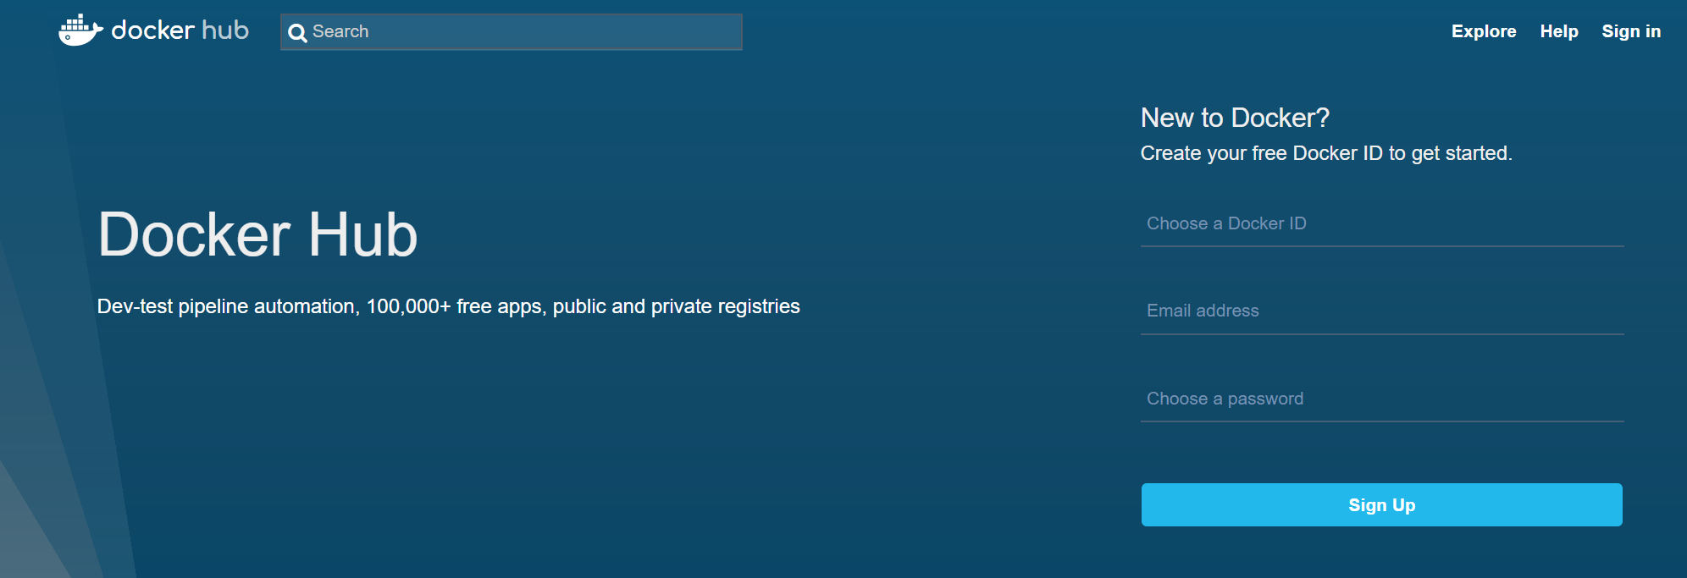
Docker Hub - hub.docker.com
Notes:
Its FREEEEEE!!!!!!

Slide 49
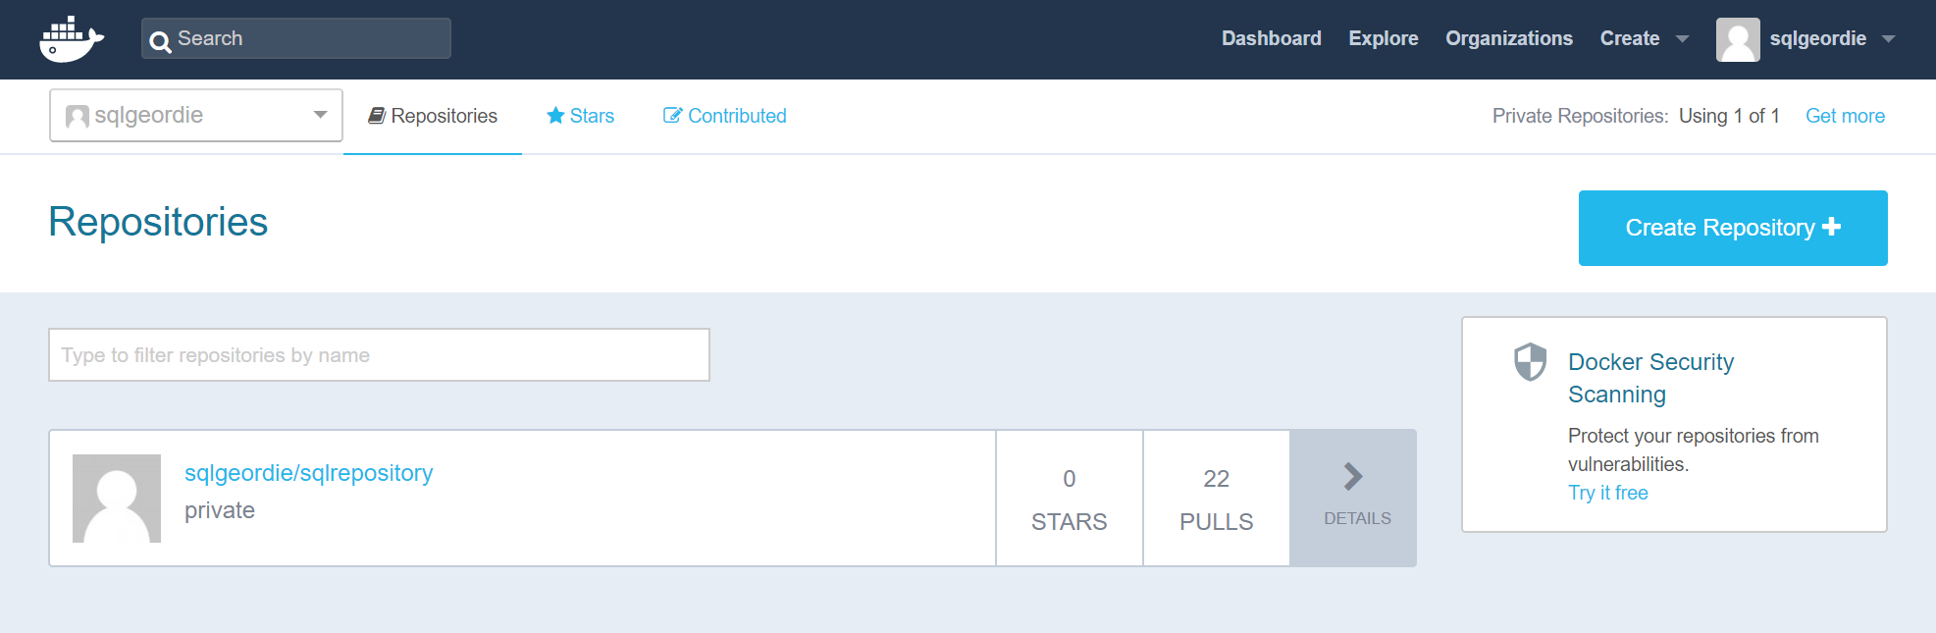
Repository
Notes:
Advise to make it private

Slide 50
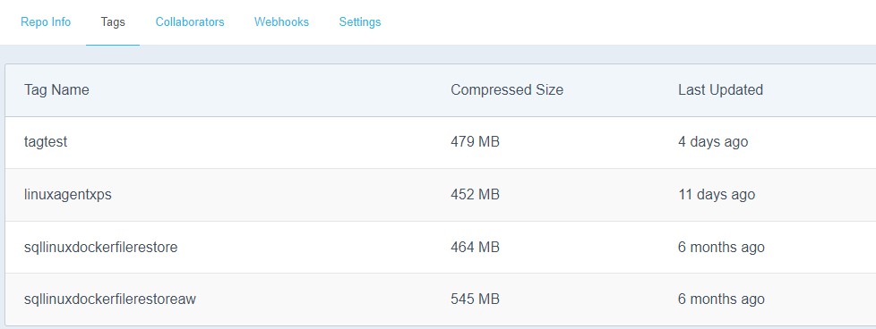
Images and Tags
Make sure you tag your images!
Notes:
Make sure you tag you images, this means that if a vendor releases a new version you don’t accidentally pull that one down and everything breaks ☺

Slide 51
Microsoft Images and Tags
mssql-server-linux | mssql-server-windows-developer | mssql-server-windows-express
2017-latest 2017-CU1 latest 2017-GA | 2017-latest latest 2017-GA 2017-CU1 2017 2017-windowsservercore-10.0.14393.1715 2016-sp1 2016-sp1-windowsservercore-10.0.14393.1715 2016-sp1-windowsservercore-10.0.14393.1480 2016-sp1-windowsservercore-10.0.14393.1198 2016-sp1-windowsservercore-10.0.14393.693 | 2017-latest latest 2017-GA 2017-CU1 2017-windowsservercore-10.0.14393.1715 2017 2016-sp1 2016-sp1-windowsservercore-10.0.14393.1715 2016-sp1-windowsservercore-10.0.14393.1480 2016-sp1-windowsservercore-10.0.14393.1198 2016-sp1-windowsservercore-10.0.14393.693 2016-windowsservercore-10.0.14393.447 2016 2016-sp1-windowsservercore-10.0.14393.447
*Notice there is nothing pre-2016, MSFT do not support these but there are some publicly available – see Andrew Pruski - https://hub.docker.com/u/dbafromthecold/
Notes:
List correct as of 06/11/2017
Notice that there are no paid for versions of SQL Server…….this is because this is a public repository ☺
Notice there is nothing pre-2016, MSFT do not support these but there are some publicly available – see Andrew Pruski - https://hub.docker.com/u/dbafromthecold/

Slide 52
Docker Hub DEMO
Notes:
1 – SQLLinuxDemoTagAndPush
2 - Show tagging of images
3 – Push example to sqlrepository on hub.docker.com

Slide 53
Logs and Trouble Shooting
Limited monitoring out the box
Docker Knowledge Hub
docker logs <container_name>
docker system <df, events, info, prune>
Docker Cli logs
Could use TP tools
eg. SentryOne, cAdvisor (Google)
https://docs.docker.com/docker-for-windows/troubleshoot/
Notes:
Can be difficult to troubleshoot
Don’t always get errors, especially with Dockerfile, see PID1 shutdown when running Linux shell scripts
docker system df - Show docker disk usage
docker system events - Get real time events from the server
docker system info - Display system-wide information
docker system prune - Remove unused data

Slide 54
Docker-Compose(Multi-Container Applications)
docker-compose <build>
yml (YAML) files
version: "3"
services:
web:
build: .
ports:
- "8000:80"
depends_on:
- db
db:
image: "microsoft/mssql-server-linux"
environment:
SA_PASSWORD: "your_password"
ACCEPT_EULA: "Y"
Notes:
This file defines the web and database micro-services, their relationship, the ports they are using, and their specific environment variables.
Can add various other things:
version: '2'
services:
sqlserver:
image: microsoft/mssql-server-windows-express
container_name: sqlserver2
ports:
["1433:1433"]
volumes:
- c:\Databases:c:\Databases
environment:
sa_password: P@ssW0rd
accept_eula: Y
attach_dbs: "[{'dbName':'trunk','dbFiles':['c:\\\\Databases\\\\trunk.mdf','c:\\\\Databases\\\\trunk_Log.ldf']}]"
networks:
default:
ipv4_address: 192.168.128.10
aliases:
- qsql
networks:
default:
external:
name: nat

Slide 55
Licensing (Docker)
Community Edition (CE)
Free!
Enterprise Edition (EE)
3 Levels (Basic / Standard / Advanced)
$1500 - $3500 / Node / yr
EE Basic free for Windows Server 2016 customers
https://www.docker.com/pricing
Notes:
For production, licensing is at the host level, i.e. each machine or VM which is running Docker. Your Windows licence on the host allows you to run any number of Windows Docker containers on that host. With Windows Server 2016 you get the commercially supported version of Docker included in the licence costs, with support from Microsoft and Docker, Inc.
For development, Docker for Windows runs on Windows 10 and is free, open-source software. Docker for Windows can also run a Linux VM on your machine, so you can use both Linux and Windows containers in development. Like the server version, your Windows 10 licence allows you to run any number of Windows Docker containers.
Windows admins will want a unified platform for managing images and containers. That’s Docker Datacenter which is separately licensed, and will be available for Windows soon.

Slide 56
Licensing (Windows)
Production
Development
Licensing is at the host level,
each machine or VM which is running Docker.
run any number of Windows Docker containers on that host.
Windows Server 2016
support from Microsoft and Docker, Inc.
Docker CE runs on Windows 10 and is free, open-source software.
Like the server version, run any number of Windows Docker containers.
https://blog.docker.com/2017/01/docker-windows-server-image2docker/
Notes:
For production, licensing is at the host level, i.e. each machine or VM which is running Docker. Your Windows licence on the host allows you to run any number of Windows Docker containers on that host. With Windows Server 2016 you get the commercially supported version of Docker included in the licence costs, with support from Microsoft and Docker, Inc.
For development, Docker for Windows runs on Windows 10 and is free, open-source software. Docker for Windows can also run a Linux VM on your machine, so you can use both Linux and Windows containers in development. Like the server version, your Windows 10 licence allows you to run any number of Windows Docker containers.
Windows admins will want a unified platform for managing images and containers. That’s Docker Datacenter which is separately licensed, and will be available for Windows soon.

Slide 57
Licensing (SQL Server)
“Regardless of where you run it - VM, Docker, physical, cloud, on prem - the licensing model is the same and it depends on which edition of SQL Server you are using.”
https://github.com/Microsoft/mssql-docker
Notes:
For production, licensing is at the host level, i.e. each machine or VM which is running Docker. Your Windows licence on the host allows you to run any number of Windows Docker containers on that host. With Windows Server 2016 you get the commercially supported version of Docker included in the licence costs, with support from Microsoft and Docker, Inc.
For development, Docker for Windows runs on Windows 10 and is free, open-source software. Docker for Windows can also run a Linux VM on your machine, so you can use both Linux and Windows containers in development. Like the server version, your Windows 10 licence allows you to run any number of Windows Docker containers.
Windows admins will want a unified platform for managing images and containers. That’s Docker Datacenter which is separately licensed, and will be available for Windows soon.

Slide 58
Performance
See link to Simon Sabin’s blog:
https://sabin.io/blog/sql-server-container-performance/
Summary:
“The container seems a bit faster up to four users, but then trails off with the VM being faster later on.”
Expected the container to outperform the VM by a factor of 10-20%.
Difficult to draw any real conclusions.
Not enough reasons from a performance standpoint to recommend containers for database hosting in an enterprise environment.”

Slide 59
Alternatives and TPVs
WinDocks
Allows images of older versions of SQL Server to be created
Portainer.io
GUI based tool
Kubernetes
Docker Swarm
Amazon Elastic Container Service (ECS)
Azure Container Service
Marathon
CoreOS Fleet
Open Stack Magnum
Diego
Hashicorp Nomad
Notes:
Windocks requires SQL Server installation on the host

Slide 60
Conclusion
Good
Not so good
Docker provides a facility to quickly provision environments
Consolidation and Resource savings can be exceptional
Docker Hub has 10000’s of publicly available repositories / images
Storage fiddly / not user friendly
Lack of monitoring via Docker
TP tools available – cAdvisor
Platform Independency still in its infancy
Windows Docker Service
Notes:
This is all still relatively new
MSFT are investing a lot of time and effort into containers, especially for DevOps

Slide 61
Summary
Session Aim
What are containers?
Containers vs Virtual Machines
Images
Getting Setup
Volumes
Dockerfile
Docker Hub
Docker Compose

Slide 62
Contact
Twitter
@SQLGeordie
Email
chris.taylor@jarrinconsultancy.com
Blog
www.jarrinconsultancy.com\blog
www.chrisjarrintaylor.co.uk

Slide 63
Questions?

Slide 64
Links
SQL Server on Linux:
SQLPAL: https://blogs.technet.microsoft.com/dataplatforminsider/2016/12/16/sql-server-on-linux-how-introduction/
Getting Started:
Docker 101: https://www.slideshare.net/Docker/docker-101-nov-2016?next_slideshow=2Docker 101 - Nov 2016
https://www.simple-talk.com/sysadmin/virtualization/working-windows-containers-docker-basics/
Simple Hello World on nanoserver:
https://docs.microsoft.com/en-us/virtualization/windowscontainers/quick-start/quick-start-windows-10

Slide 65
Links
Introduction:
Docker introduction
General:
https://blog.sixeyed.com/windows-containers-and-docker-5-things-you-need-to-know/
Licensing:
https://blog.docker.com/2017/01/docker-windows-server-image2docker/
Installing:
https://mathaywardhill.com/2017/04/12/installing-sql-server-vnext-on-linux-using-docker-on-windows-10/
SQL On Linux:
https://docs.microsoft.com/en-us/sql/linux/sql-server-linux-setup-docker
https://roadtoalm.com/2017/01/06/running-a-linux-sql-server-in-a-docker-container/
Connecting to SQL via sqlcmd:
http://searchsqlserver.techtarget.com/tip/Use-these-commands-to-deploy-SQL-Server-Docker-containers

Slide 66
Links
Nested Virtualisation (for VMs):
https://www.youtube.com/watch?v=ycCK1EyJG6Y (nested virtualisation)
Windocks:
https://www.windocks.com/blog-2/Windows-Containers-at-Work
Performance:
https://sabin.io/blog/sql-server-container-performance/
https://facility9.com/2017/01/how-do-i-update-my-sql-server-docker-container/
Error pushing image (add collaborators):
http://stackoverflow.com/questions/41984399/denied-requested-access-to-the-resource-is-denied-docker/42403423
Terminology:
http://itproguru.com/expert/2016/10/docker-create-container-change-container-save-as-new-image-and-connect-to-container/
Volumes:
http://paper.li/e-1483951345?read=http%3A%2F%2Fthedatafarm.com%2Fdata-access%2Fmashup-sql-server-on-linux-in-docker-on-a-mac-with-visual-studio-code%2F
http://www.tricksofthetrades.net/2016/03/14/docker-data-volumes/
https://www.richard-banks.org/2017/03/connecting-to-sql-on-docker.html

Slide 67
Links
Hyper-V containers:
https://www.simple-talk.com/sysadmin/virtualization/working-windows-containers-docker-stride/?utm_source=simpletalk&utm_medium=pubemail&utm_content=20170512-slota2&utm_term=simpletalkmain
https://hyper-v.nu/archives/hvredevoort/2015/05/nested-hypervisor-in-windows-server-vnext/
https://blogs.technet.microsoft.com/uktechnet/2016/01/11/windows-containers-what-they-are-and-how-they-work/
Windows Server and Docker - The Internals Behind Bringing Docker and Containers to Windows by Taylor Brown and John Starks
Tutorials:
Docker Container Tutorial #1 Containers vs Images - Focuses on Ubuntu
Learn Docker in 12 Minutes 🐳
Learn Docker in 20 Minutes

